Slide 1
Processor Scheduling
Week 5

Slide 2
Scheduling Goals
Processor scheduling decides which ready process gets the CPU next, and for how long
Common goals:
  Throughput: finish as much work as possible
  Low waiting and response times, especially for interactive apps
  Fairness, and no process waits forever (no starvation)
  Meet deadlines, for real-time work
  Keep the CPU busy, with low overhead
  Predictability: similar jobs take a similar amount of time
Different systems weigh these differently. A phone cares about responsiveness and battery, and a supercomputer cares about throughput

Slide 3
Types of Schedulers
Long-term: decides which jobs get loaded into memory, which controls the degree of multiprogramming
  On a laptop it barely exists, since every app you open just runs. It lives on in job queues for supercomputers and the cloud, such as Slurm
Medium-term: moves processes out of memory and back again (swapping), covered in Week 11
Short-term: picks which ready process runs next on the CPU. This is what most of this week is about
Notes:
Slurm Workload Manager: Overview: https://slurm.schedmd.com/overview.html

Slide 4
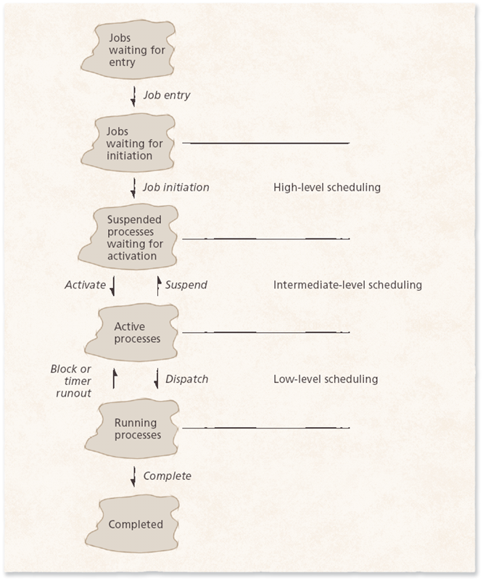
Scheduling Levels
The picture shows the three levels: high-level (long-term), intermediate-level (medium-term), and low-level (short-term)
Low-level scheduling happens many times every second

Slide 5
Process Activities
Every process repeats a cycle:
  Wait in the ready queue for the CPU
  Run for its CPU burst, or until its time slice runs out
  Wait for I/O, or go back to the ready queue
When it has no more work to do, it ends
CPU-bound processes mostly compute, like a video export. I/O-bound processes mostly wait, like a text editor waiting for you to type

Slide 6
Priorities
Some kinds of processes get priority over others, such as system processes over background tasks
Static priorities never change: simple and low overhead, but they can't react to what's happening
Dynamic priorities change as the system runs: more responsive and smoother, for a little more overhead

Slide 7
Implementing Dynamic Priority
The OS guesses from recent behavior: a process will probably keep doing what it just did
Give the CPU to the highest priority process, with a time slice
  If it stops early to wait for I/O, raise its priority. It's probably interactive
  If it uses its whole time slice, lower its priority. It's probably CPU-bound
This keeps the apps you're using quick, while long jobs still make progress

Slide 8
Starvation and Aging
Giving some processes priority isn't fair, by design
Starvation: a low-priority process waits forever, because higher-priority work keeps arriving
Aging: slowly raise a process's priority the longer it waits, until it finally runs
  Selfish round-robin is one example: waiting processes gain priority until they join the active queue

Slide 9
Preemptive vs. Nonpreemptive Scheduling
Preemptive: the OS can take the CPU away from a running process
  Better response times, and needed for interactive systems
Nonpreemptive: a process runs until it finishes or gives up the CPU
  A long or stuck process can block everything else
Every modern desktop and phone OS is preemptive
Historical note: Windows 3.1 and classic Mac OS used cooperative multitasking, where each app had to give up the CPU on its own, so one frozen app could freeze the whole computer. Still worth knowing because it shows exactly why preemption matters

Slide 10
First-In-First-Out (FIFO) Scheduling
Processes run in the order they arrive
Nonpreemptive, and simple to understand
Fair in one sense, since everyone waits their turn, but short jobs get stuck behind long ones
Rarely used on its own, but it's part of other schedulers

Slide 11
Shortest Job First (SJF)
Also called shortest process first (SPF), or shortest process next
Runs the process with the shortest next CPU burst first
Gives the lowest average waiting time of any nonpreemptive method
But it has to guess run times, and those guesses can be wrong, or even faked
Long processes can wait a very long time, so it's a poor fit for interactive systems

Slide 12
Priority Scheduling
Each process gets a priority, and the highest priority ready process runs next
Nonpreemptive: a new high-priority process waits for the current one to finish
Preemptive: a new high-priority process takes the CPU right away
Needs aging, or low-priority processes can starve

Slide 13
Highest-Response-Ratio-Next (HRRN)
An improvement on shortest job first
Looks at both how long a process has waited and how long it needs to run
The longer a process waits, the higher its priority, so nothing waits forever
Still nonpreemptive

Slide 14
Round-Robin (RR) Scheduling
Like FIFO, but each process only runs for a short time slice (quantum), usually a few milliseconds
When its slice runs out, it goes to the back of the line. The ready queue works like a circle
Preemptive, and built for time-sharing systems
Picking the time slice:
  Too long, and it acts just like FIFO
  Too short, and the system spends more time context switching (Week 2) than running processes
  Just right: long enough for interactive processes to start their next I/O

Slide 15
Shortest-Remaining-Time (SRT) Scheduling
The preemptive version of shortest job first
A new process with a shorter run time takes the CPU from the running one
Long processes wait even longer than with shortest job first
Lots of switching adds overhead, and a nearly finished process can get bumped

Slide 16
Scheduling Example: The Setup
Four processes arrive at time 0, in this order:
  P1 needs 8 units of CPU time
  P2 needs 4
  P3 needs 2
  P4 needs 1
Waiting time: how long a process sits in the ready queue before it finishes
Next: the same four processes under FIFO, shortest job first, and round-robin

Slide 17
Scheduling Example: Three Schedulers
FIFO
average wait 8.5
P1
P2
P3
P4
Shortest job first
average wait 2.75
P4
P3
P2
P1
Round-robin
time slice 2
average wait 6
P1
P2
P3
P4
P1
P2
P1
P1
0
1
2
3
4
5
6
7
8
9
10
11
12
13
14
15
Time units
Notes:
Timeline (Gantt) charts for the four processes.
FIFO: P1 0-8, P2 8-12, P3 12-14, P4 14-15. Average wait 8.5.
Shortest job first: P4 0-1, P3 1-3, P2 3-7, P1 7-15. Average wait 2.75.
Round-robin, time slice 2: P1 0-2, P2 2-4, P3 4-6, P4 6-7, P1 7-9, P2 9-11, P1 11-15. Average wait 6.

Slide 18
What the Example Shows
FIFO: average wait 8.5. Simple, but the short jobs get stuck behind the long one
Shortest job first: average wait 2.75, the best average. But it needs to know run times ahead of time, and long jobs can starve
Round-robin: average wait 6. Everyone gets a turn quickly, and every process starts within 6 time units
Real schedulers mix these ideas, to be both fast and fair

Slide 19
Multilevel Feedback Queues
Quick interactive apps should usually run before long background jobs
New processes start in the top queue, with the highest priority
Processes that use their whole time slice move down a level
So short and I/O-bound processes stay near the top, and long jobs sink to the bottom
Each level uses round-robin, and the lower levels run when the levels above are empty
The scheduler learns about each process from how it behaves, without being told

Slide 20
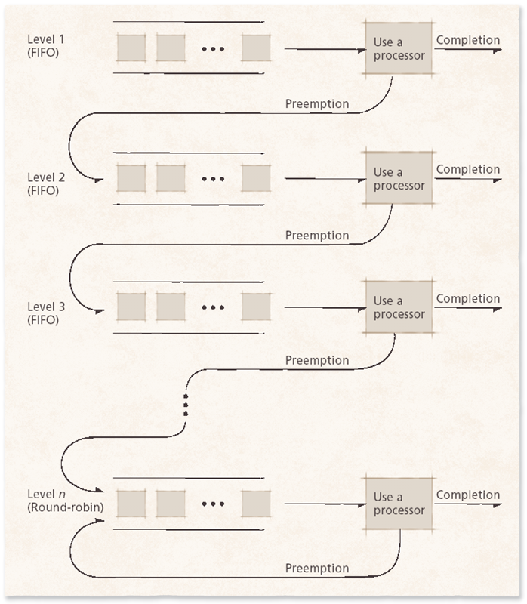
Multilevel Feedback Queues

Slide 21
Multi-Queue Scheduling
The ready queue is split into separate queues by type of process, each with its own scheduling method
For example: system processes, interactive apps, and background batch jobs
Unlike multilevel feedback queues, processes usually stay in their own queue

Slide 22
Fair Share Scheduling
Divides the CPU between groups of users or apps, not just individual processes
Stops one group from hogging the system, and passes unused time to the others
Today on Linux, cgroups do this. They're how containers and cloud servers limit each customer's share of the CPU
Notes:
Linux kernel documentation: Control Group v2: https://docs.kernel.org/admin-guide/cgroup-v2.html

Slide 23
How Linux Schedules Today
Historical note: from 2007 to 2023, Linux used the Completely Fair Scheduler (CFS). Still worth knowing because most textbooks and articles still describe it
Since 2023, Linux has used EEVDF (earliest eligible virtual deadline first)
  Each task gets a fair share of the CPU, plus a "deadline" for its next turn
  Tasks that need only short bursts, like interactive apps, get quick turns
Since 2024, sched_ext lets custom schedulers be loaded into Linux, for things like gaming and big servers
Notes:
Linux kernel documentation: CFS Scheduler: https://docs.kernel.org/scheduler/sched-design-CFS.html
Linux kernel documentation: EEVDF Scheduler: https://docs.kernel.org/scheduler/sched-eevdf.html
Linux kernel documentation: Extensible Scheduler Class: https://docs.kernel.org/scheduler/sched-ext.html

Slide 24
How Windows and macOS Schedule
Windows: preemptive, with 32 priority levels
  Gives a priority boost to the app you're using, and to threads that just finished waiting
  Task Manager's Efficiency mode lowers an app's priority and can move it to power-saving cores
macOS: apps label their work with a quality of service level, such as user-interactive or background
  The system uses that label to pick performance or efficiency cores
Notes:
Microsoft: Scheduling priorities: https://learn.microsoft.com/en-us/windows/win32/procthread/scheduling-priorities
Microsoft: Priority boosts: https://learn.microsoft.com/en-us/windows/win32/procthread/priority-boosts
Microsoft: Task Manager Efficiency mode: https://devblogs.microsoft.com/performance-diagnostics/reduce-process-interference-with-task-manager-efficiency-mode/
Apple: Prioritize work at the task level: https://developer.apple.com/library/archive/documentation/Performance/Conceptual/power_efficiency_guidelines_osx/PrioritizeWorkAtTheTaskLevel.html

Slide 25
Priorities You Can See
Linux: nice starts a program with a different priority, and renice changes a running one (Week 2)
  Example: nice -n 10 starts a big job at a lower priority, so it doesn't slow down your desktop
top shows each process's priority (PR) and nice value (NI)
Windows: Task Manager, Details tab, right-click a process, then Set priority
Setting priorities too high can make the rest of the system sluggish, so most of the time, let the OS decide
Notes:
Linux manual page: nice: https://man7.org/linux/man-pages/man1/nice.1.html

Slide 26
Real-Time Systems
A real-time system has to respond within strict time limits
It relies on priorities and preemption
Examples: a car's airbags and anti-lock brakes, pacemakers, and factory robots

Slide 27
Real-Time Scheduling
Processes have deadlines, and many run on a regular schedule (periodically)
Soft real-time: deadlines are usually met. Missing one is annoying, like a stuttering video call
Hard real-time: deadlines must always be met. Missing one can be catastrophic, like in air traffic control or airbags

Slide 28
Static Real-Time Scheduling
Priorities don't change. Low overhead, and good when conditions rarely change
  Rate-monotonic: tasks that run more often get higher priority
  Deadline rate-monotonic: for tasks whose deadline isn't the same as how often they run

Slide 29
Dynamic Real-Time Scheduling
Priorities change based on deadlines
  Earliest deadline first (EDF): always run the task whose deadline is soonest
  Minimum laxity first: run the task with the least spare time, based on its deadline and how much work it has left
The extra overhead must never cause a missed deadline

Slide 30
Real-Time on Linux
SCHED_DEADLINE lets Linux tasks use earliest deadline first
Since late 2024 (Linux 6.12), real-time support called PREEMPT_RT has been part of the main Linux kernel
  It keeps delays very short, for things like audio, robotics, and factory machines
Safety-critical systems, like airbags, still use small dedicated real-time operating systems (Week 1)
Notes:
Linux kernel documentation: Deadline Task Scheduling: https://docs.kernel.org/scheduler/sched-deadline.html
Linux kernel documentation: Real-time preemption: https://docs.kernel.org/core-api/real-time/index.html

